Slide 1
AI Testing tool
3D Test Case Modelling

Slide 2
Ai application Testing
As the use of smart devices and technology increases, we needed them to work properly and meet our expectations
We can conduct tests manually or automatically on them
To accurately assess the quality and performance of an application we need to generate and execute compressive test cases

Slide 3
Challenges
Test Case Coverage
Test Data
Automation

Slide 4

Dog Breed Identification Application
Src: https://cdn.orvis.com/images/DBS_Lab_1280.jpg

Slide 5
Dog Breed Identification
Labrador

Slide 6
Dog breed Identification
Daytime
Standing
On A Grass
Retriever,Labrador
Middle Age
Golden

Slide 7

Dog Identification Application
Src: https://res.cloudinary.com/twenty20/private_images/t_watermark-criss-cross-10/v1598380305000/photosp/d4e01602-5457-41fd-bb1c-13dc94f8da0a/stock-photo-dog-jumping-black-summer-ball-tennis-ball-labrador-spring-bright-d4e01602-5457-41fd-bb1c-13dc94f8da0a.jpg

Slide 8
Dog Identification Application
Daytime
Running
On A Grass
Retriever,Labrador
Jumping
Black
Src: https://res.cloudinary.com/twenty20/private_images/t_watermark-criss-cross-10/v1598380305000/photosp/d4e01602-5457-41fd-bb1c-13dc94f8da0a/stock-photo-dog-jumping-black-summer-ball-tennis-ball-labrador-spring-bright-d4e01602-5457-41fd-bb1c-13dc94f8da0a.jpg

Slide 9
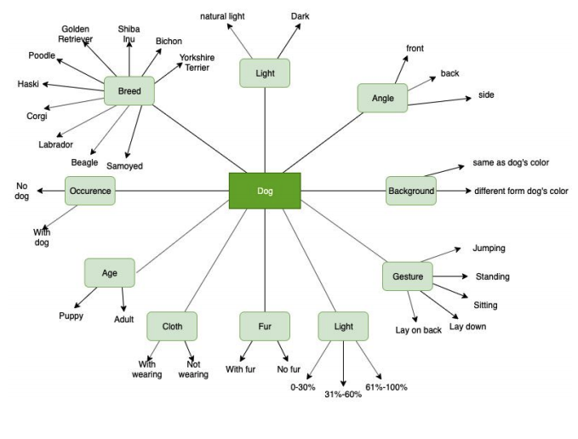
Data model

Slide 10
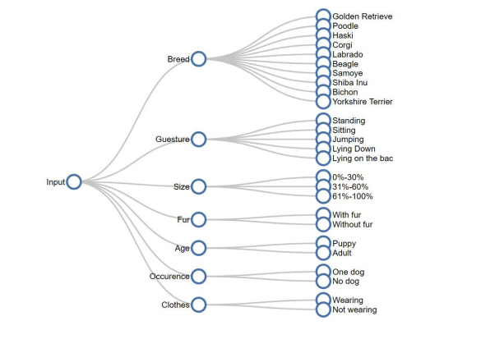
Input Classification

Slide 11
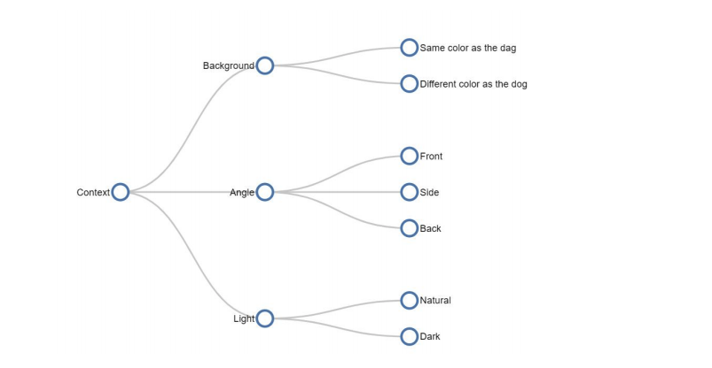
Content Classification

Slide 12
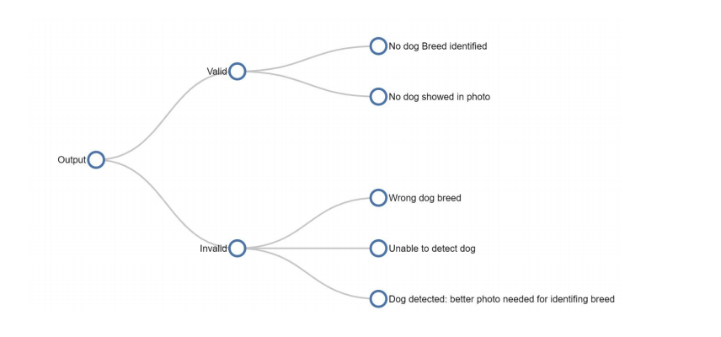
Output Classification

Slide 13
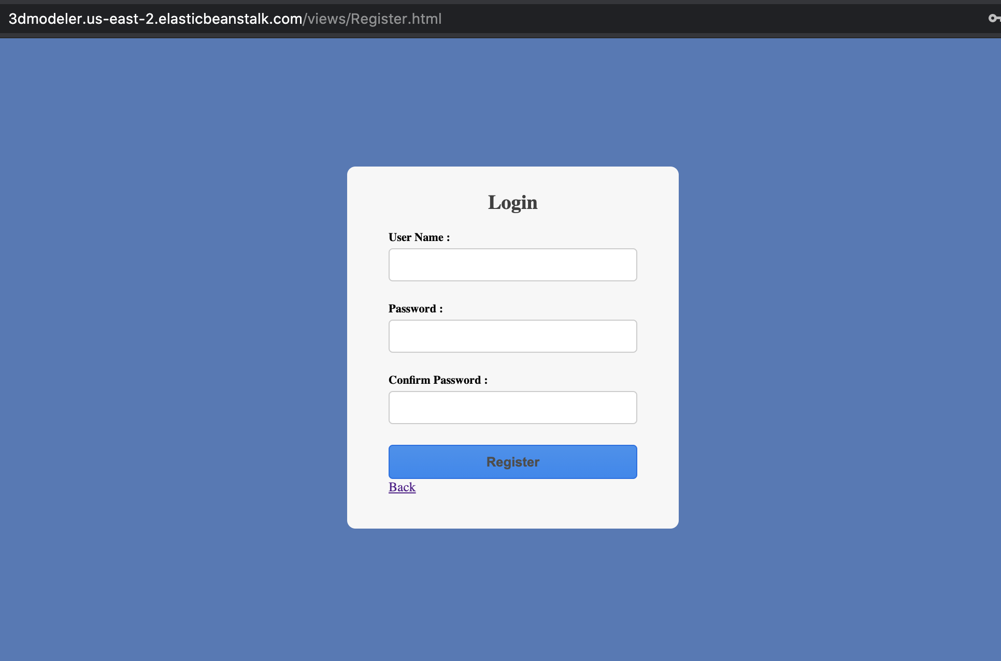
Registration

Slide 14
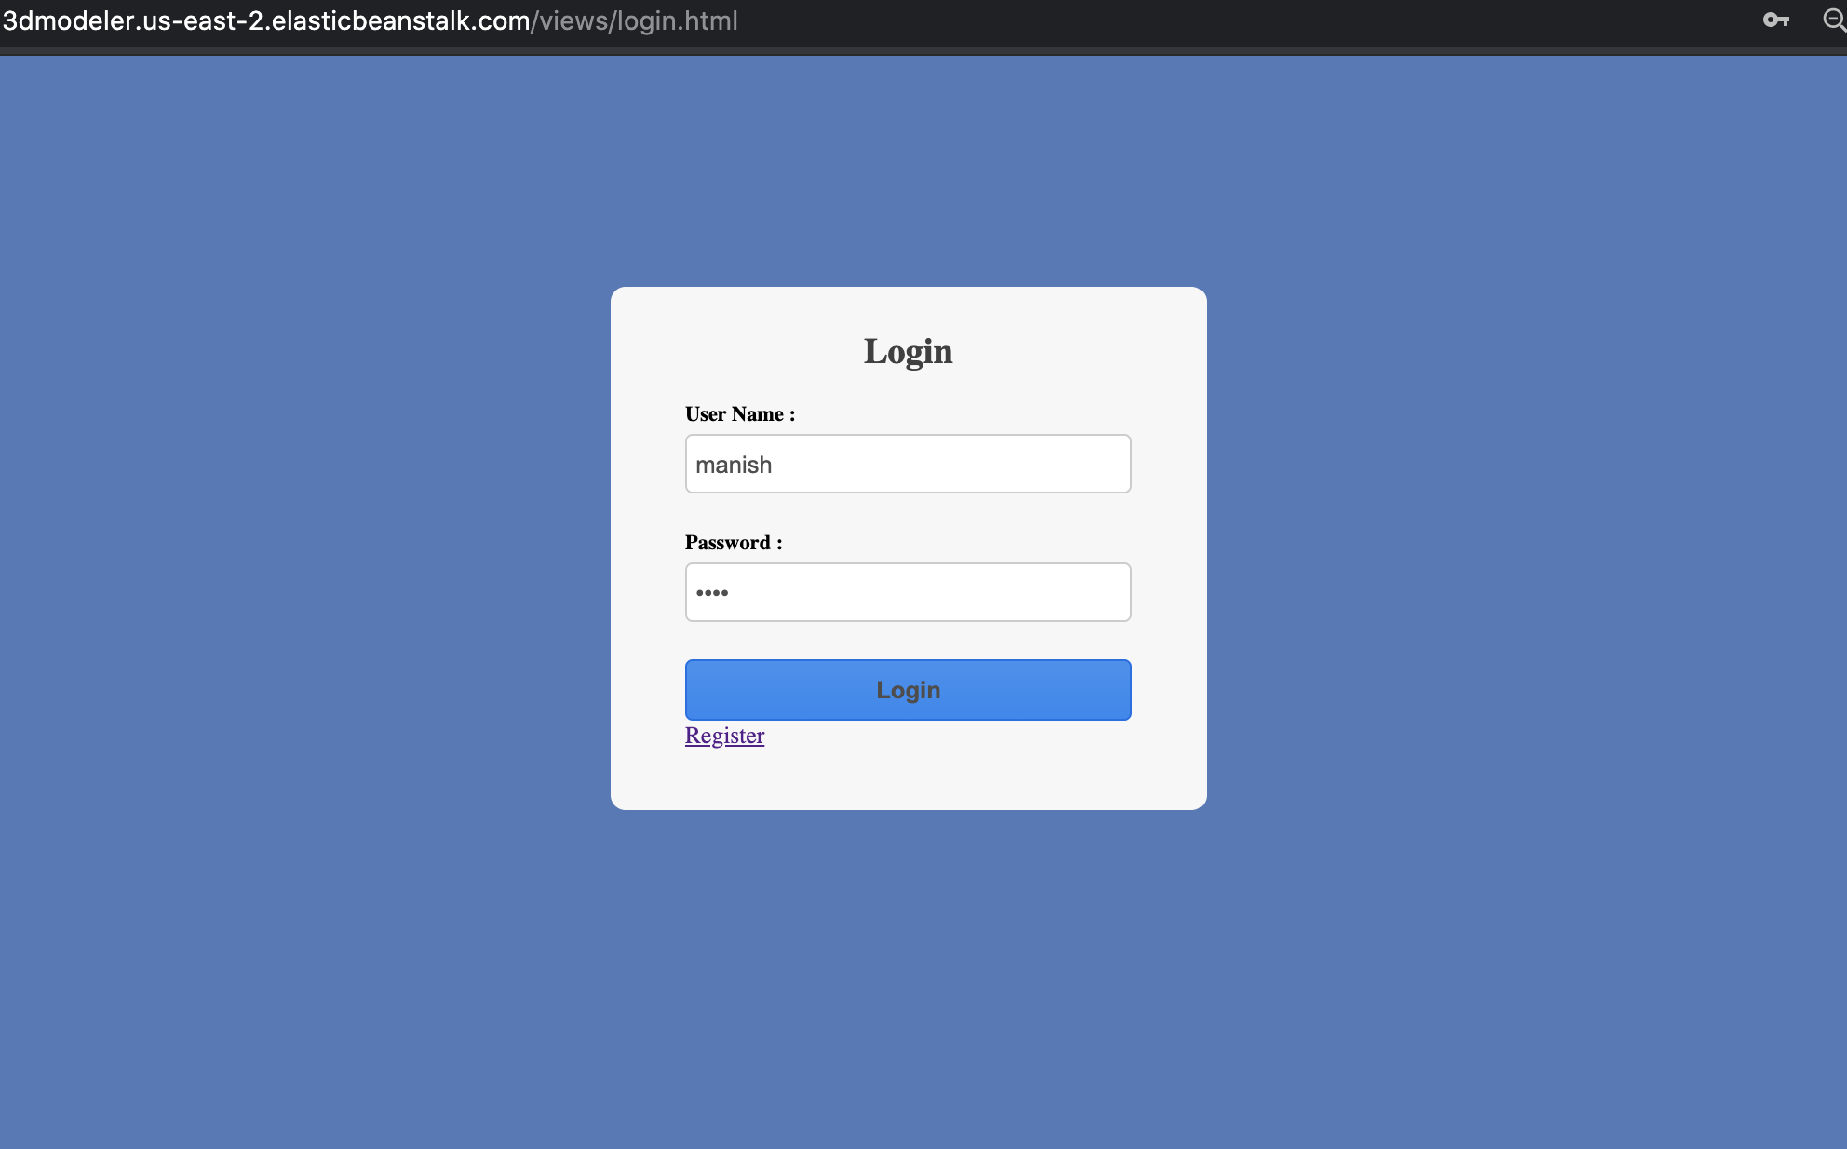
Login

Slide 15
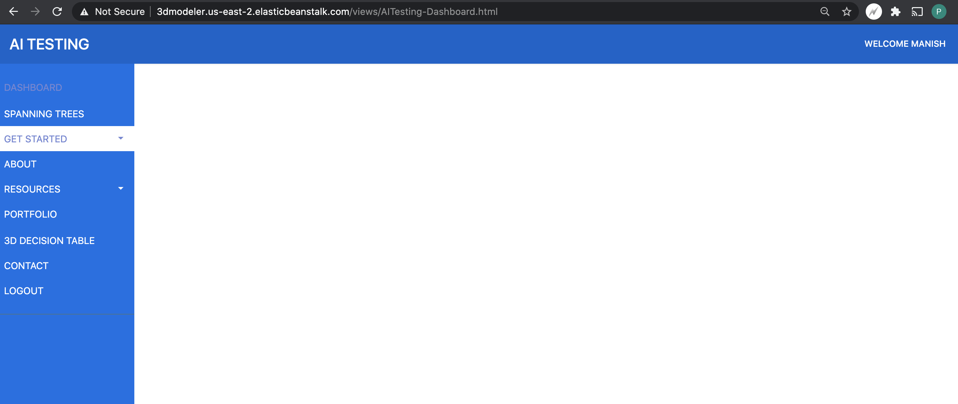
Dashboard

Slide 16
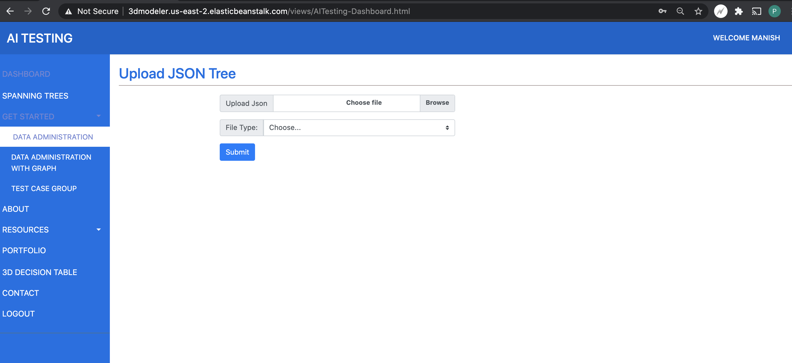
Data Administration – file upload

Slide 17
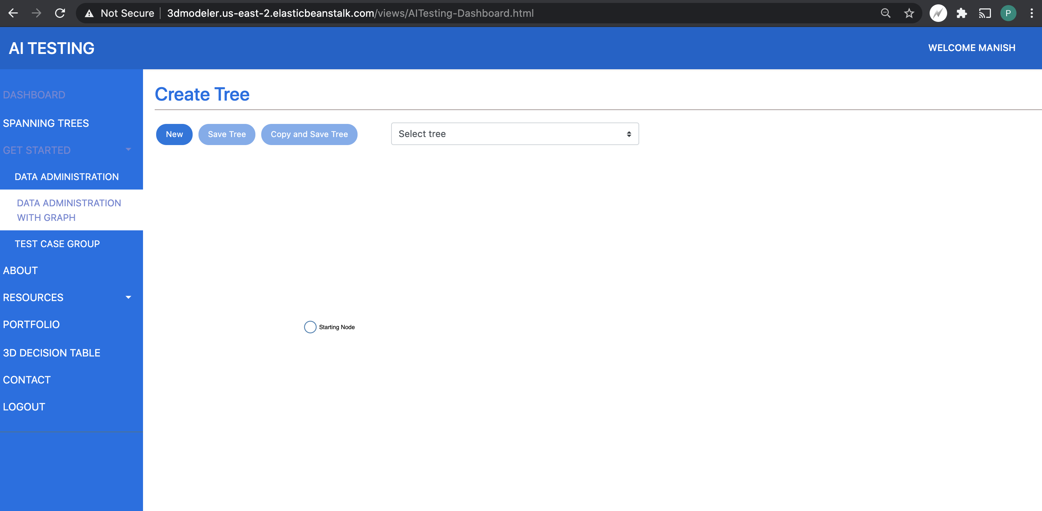
Data Administration – Graph

Slide 18
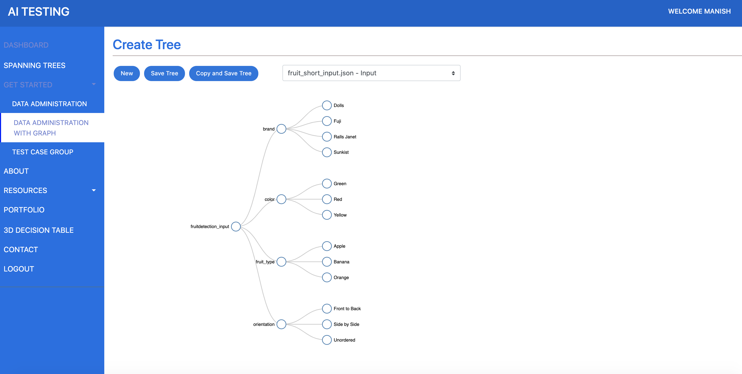
Sample Tree - Input

Slide 19
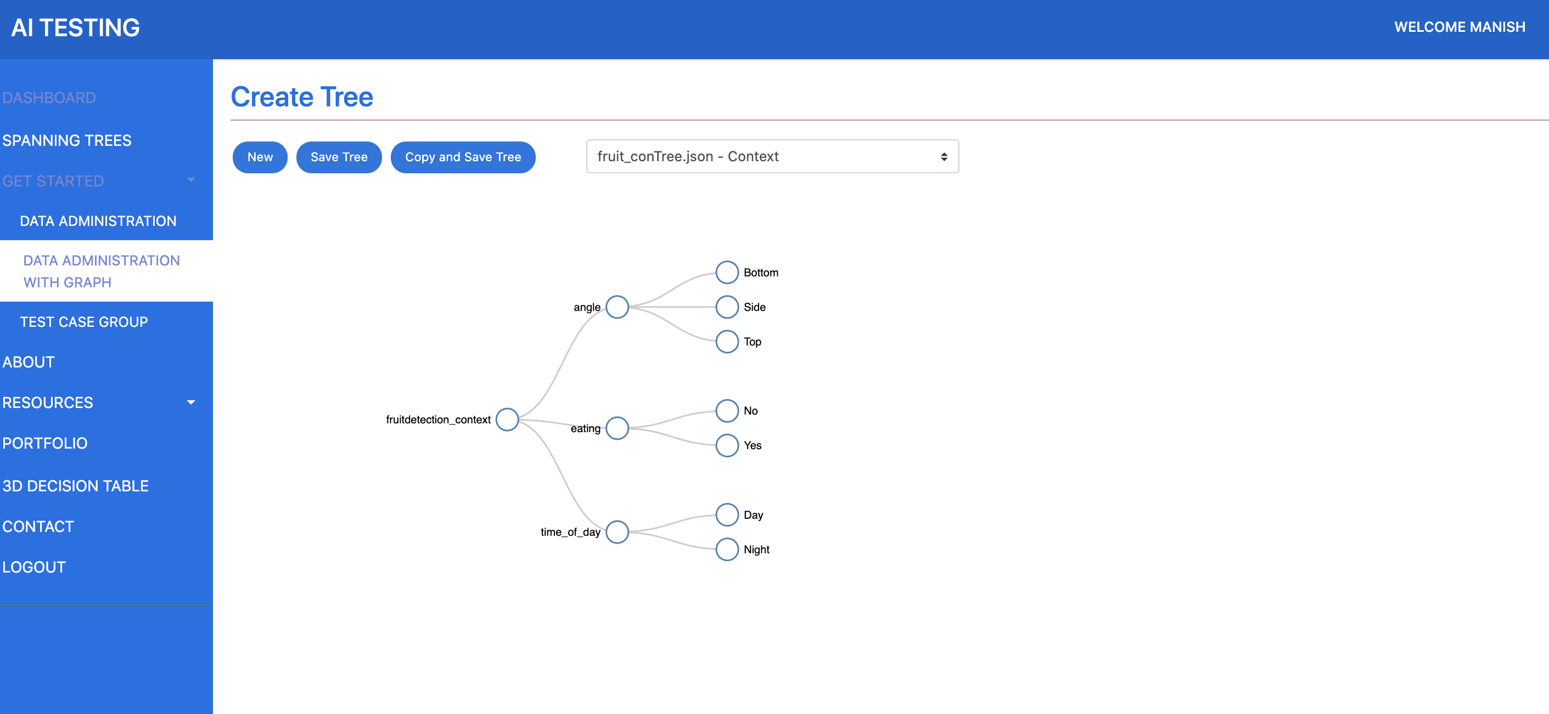
SAmple tree - Context

Slide 20

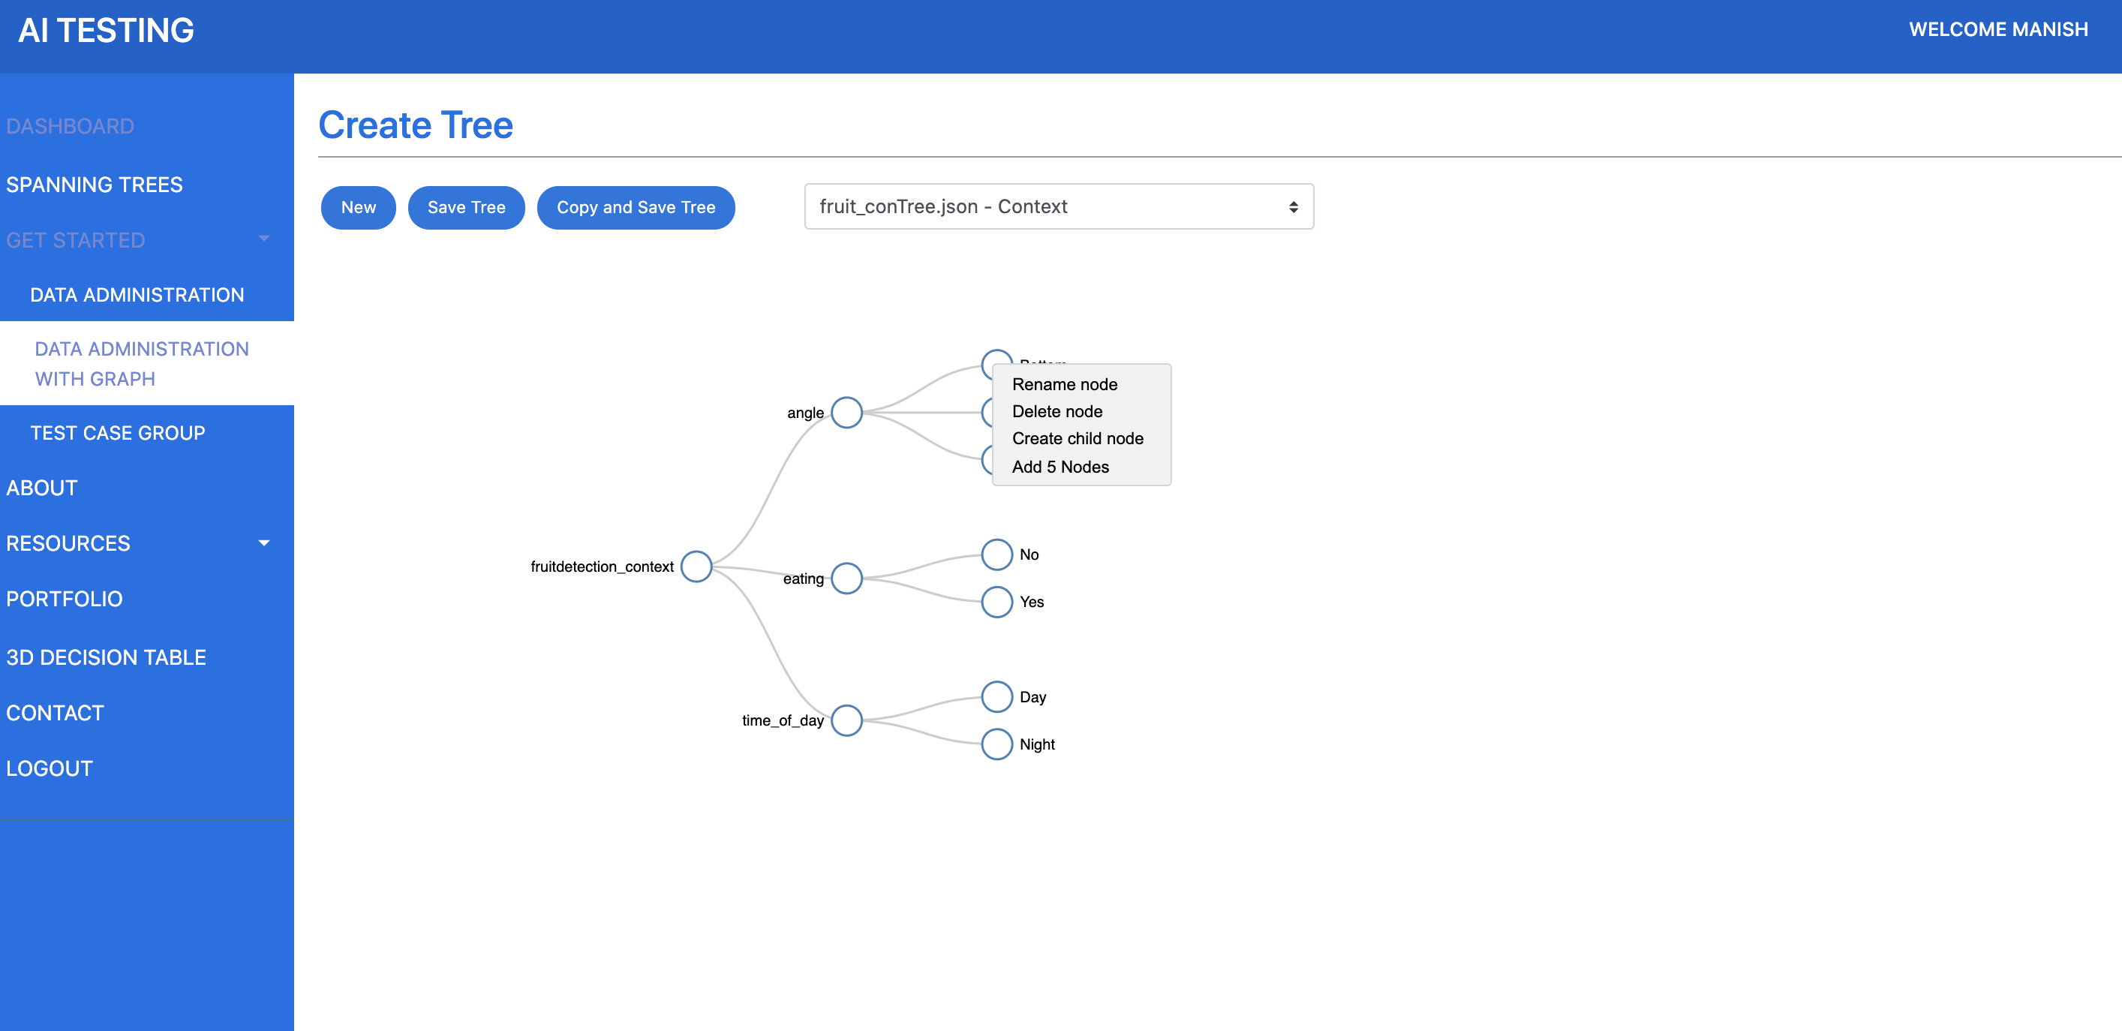

Data administration : features
Create new Tree
Edit
Rename Node
Delete Node
Add Multiple Nodes
Copy

Slide 21
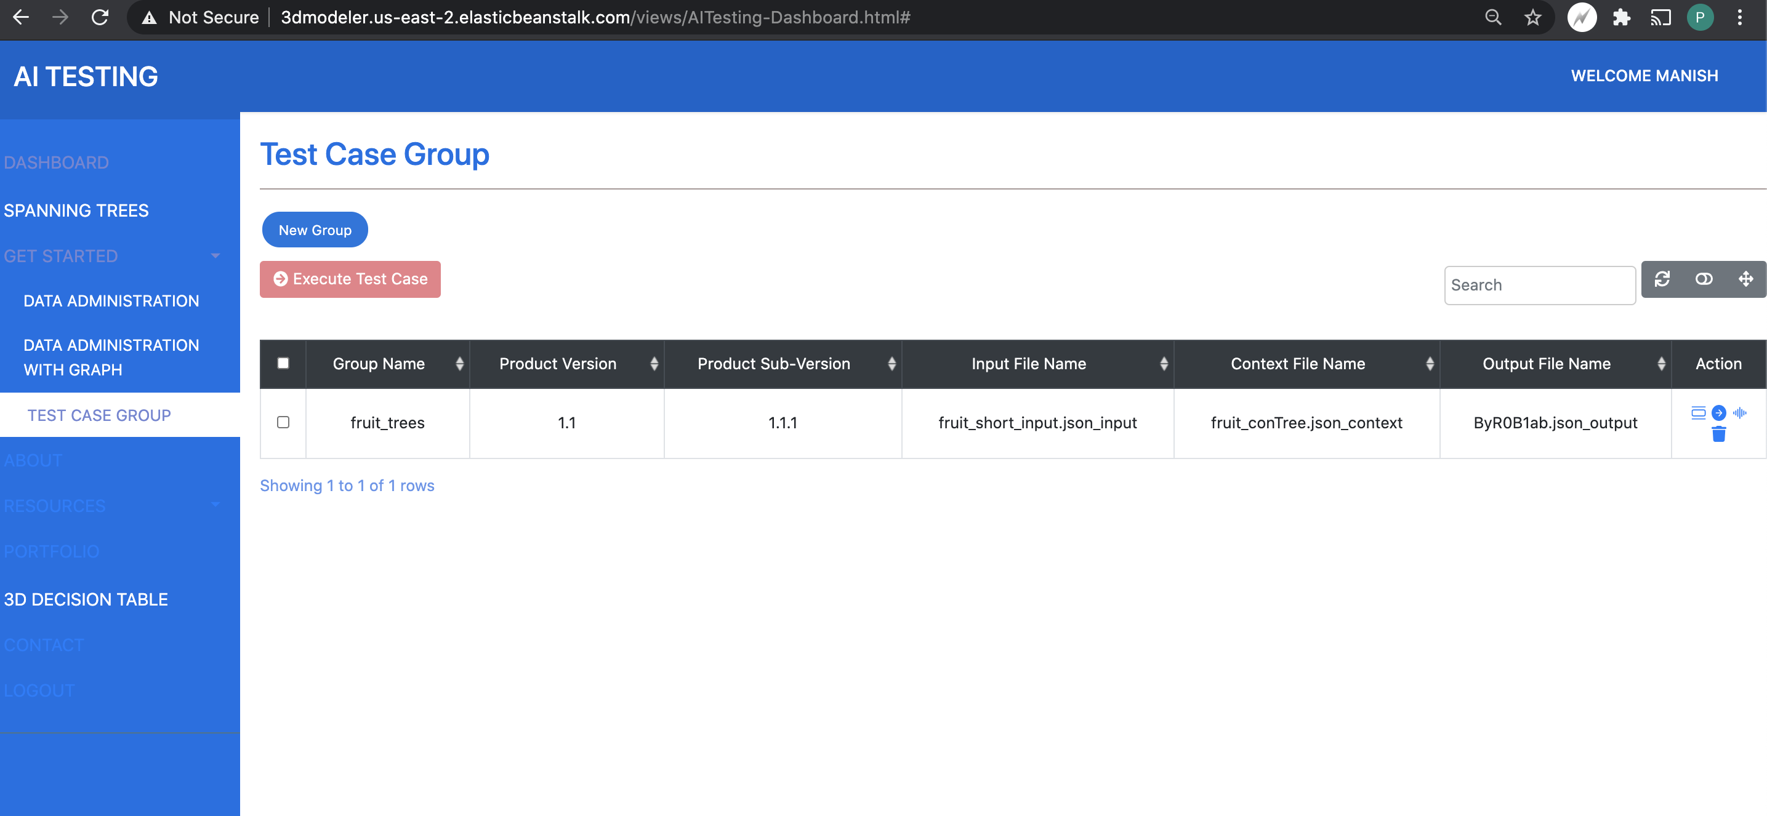
Test case group : dashboard

Slide 22
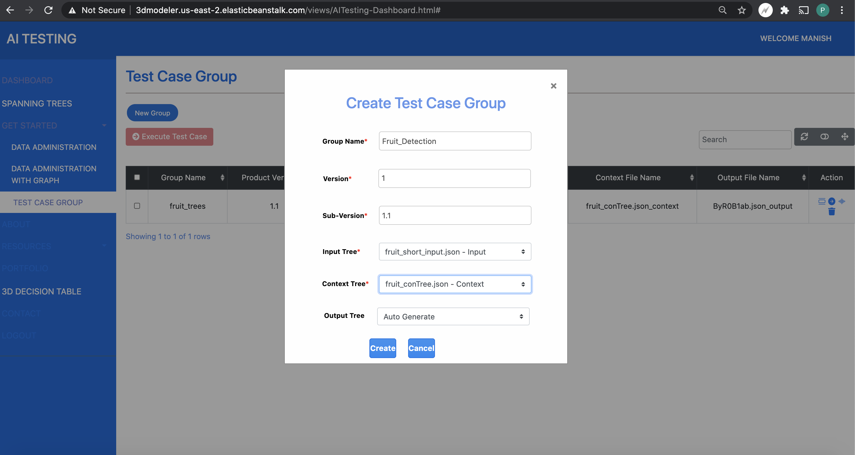
Test case group

Slide 23
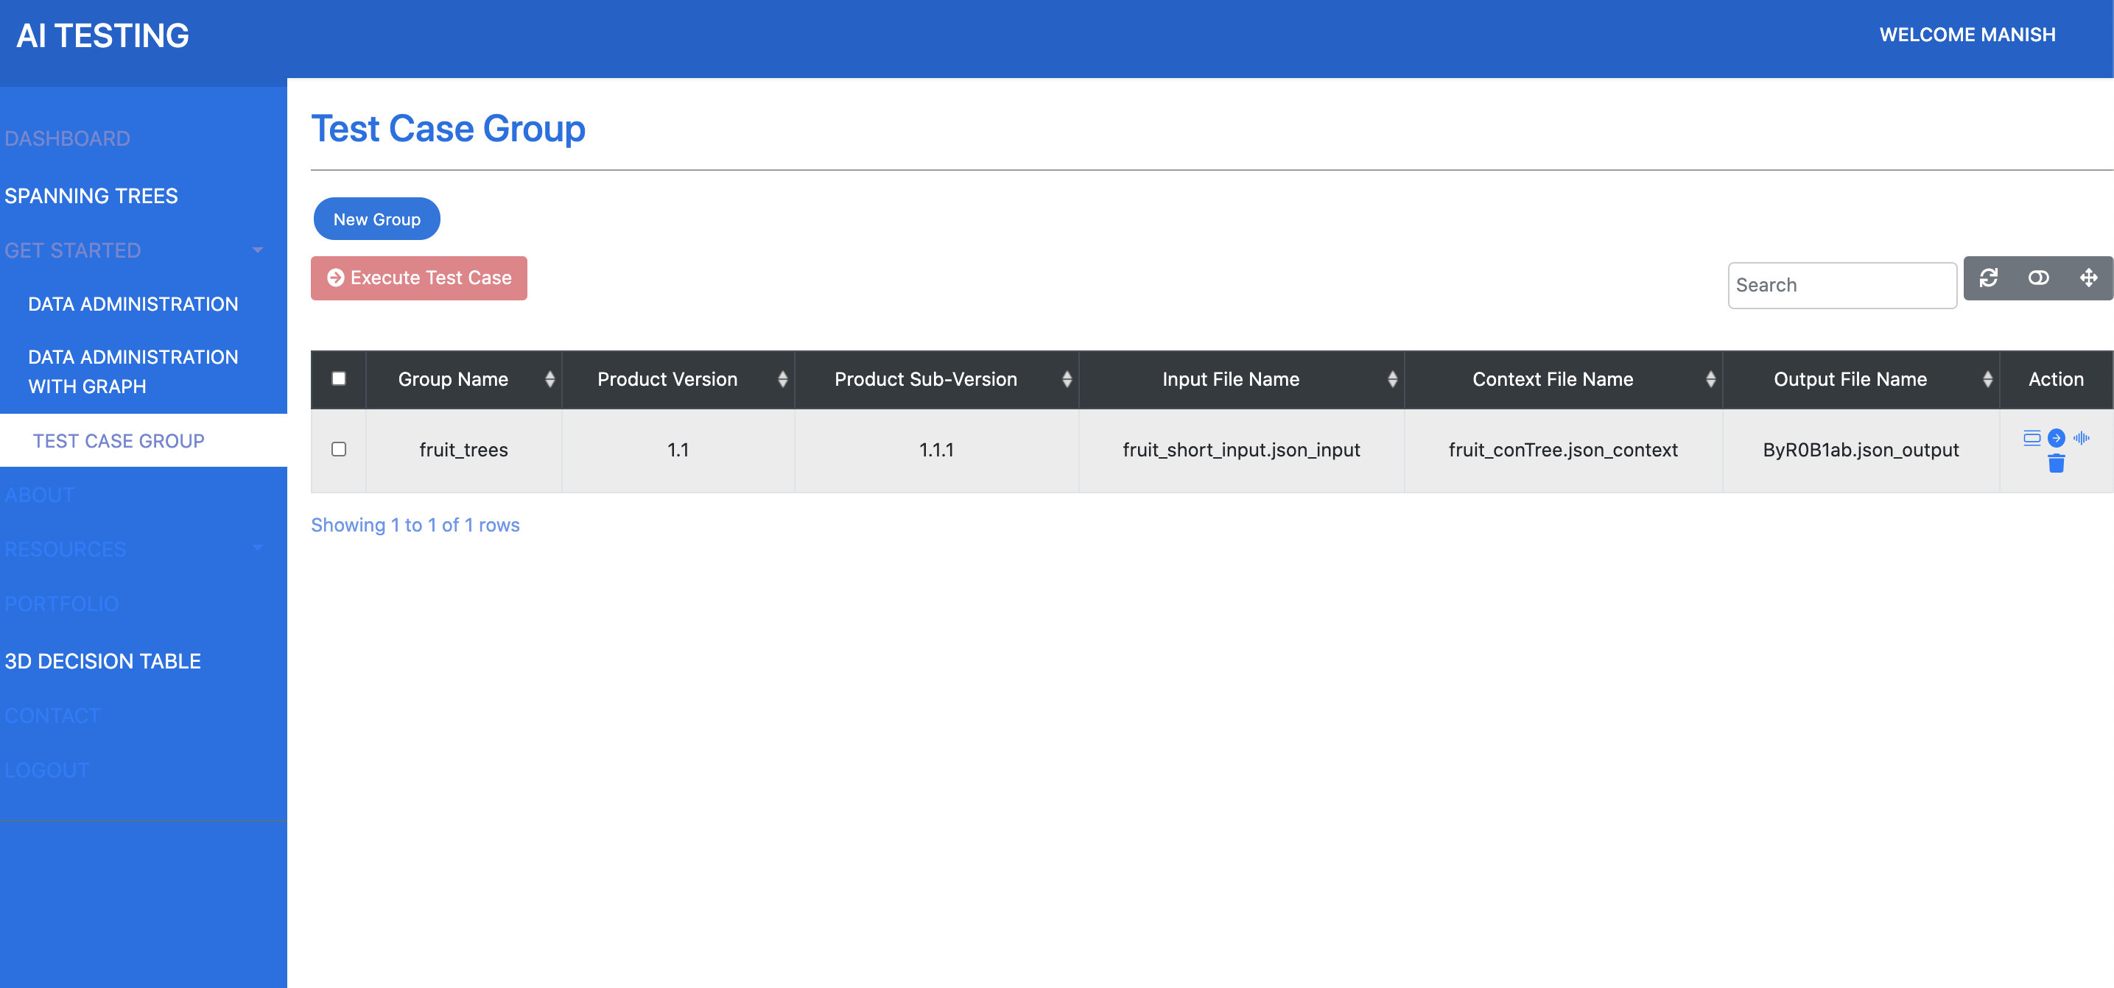
Test case group : features
Click on file Name to view tree
Actions:
Edit Test group Trees
Generate Test Cases
View Test Cases

Slide 24
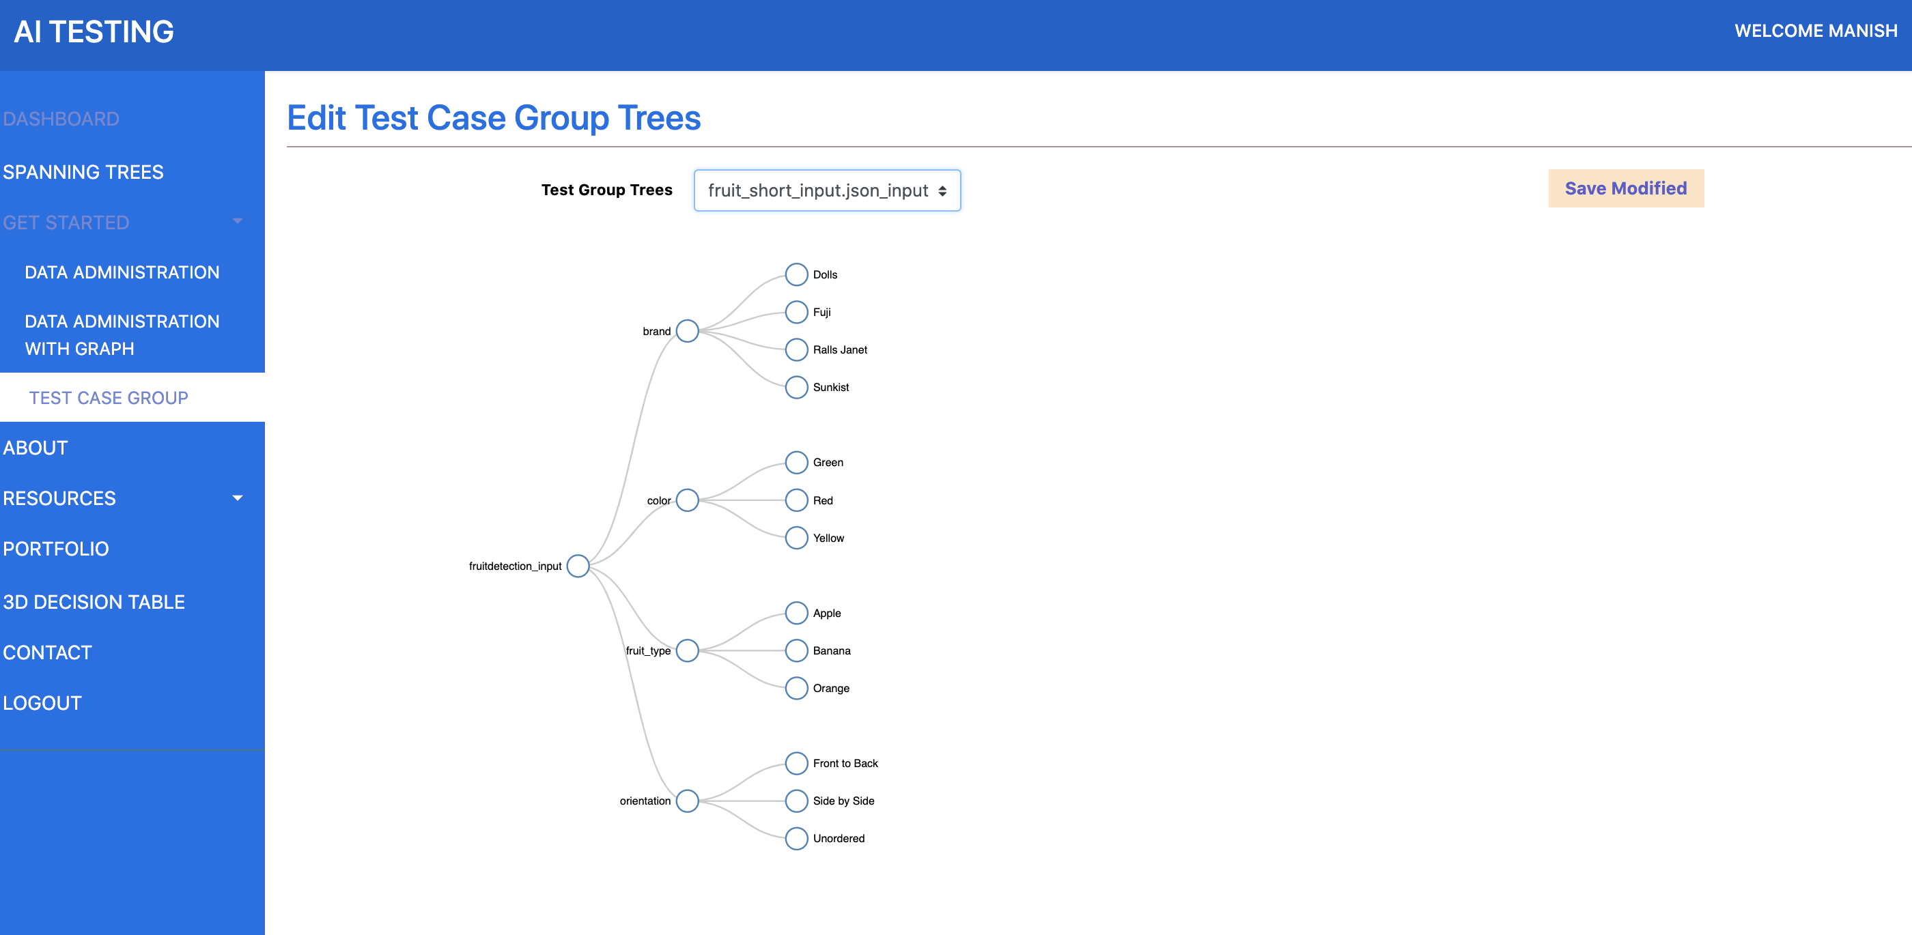
Test case group : Edit Trees

Slide 25
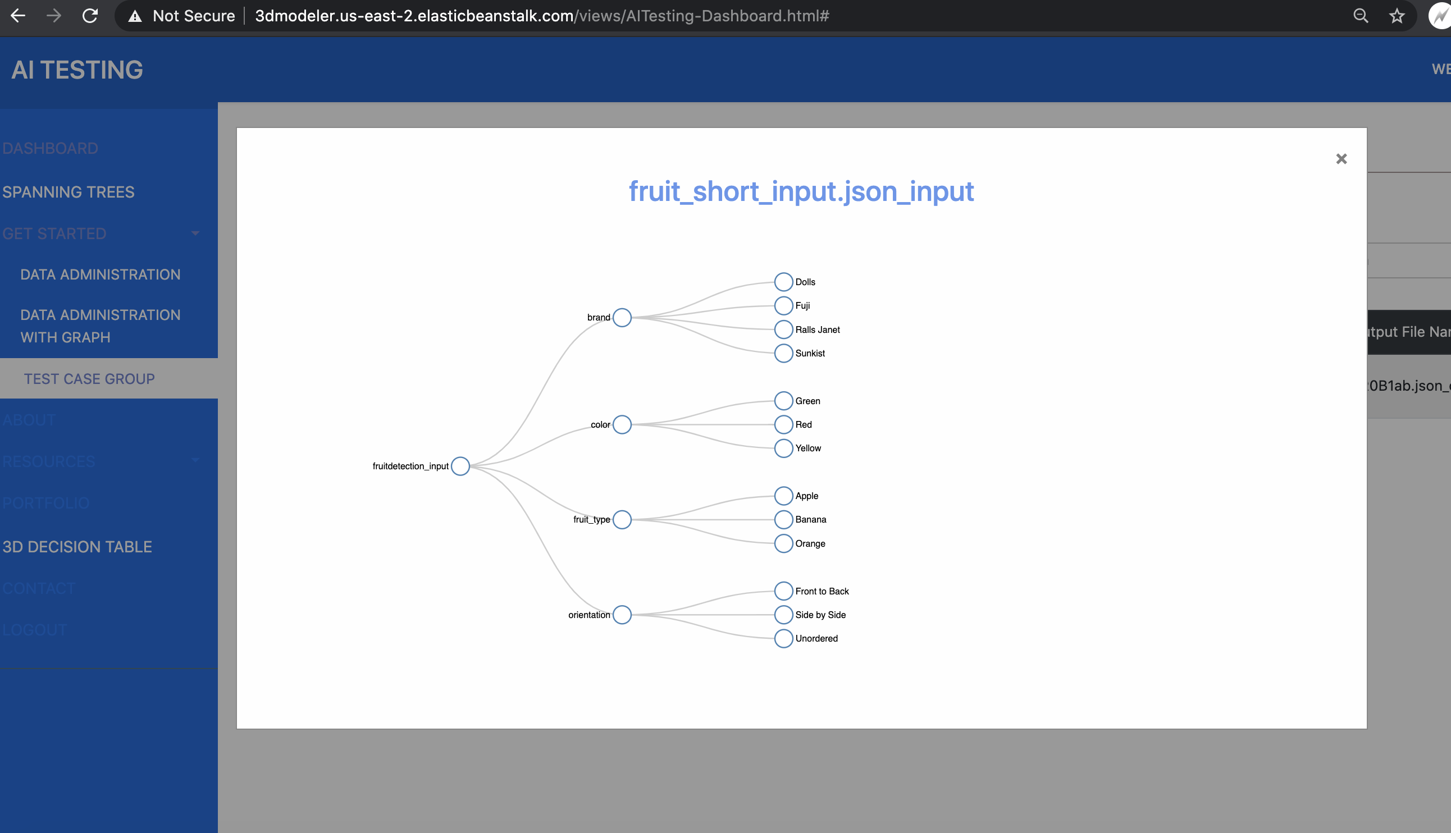
Test case group : View Trees

Slide 26
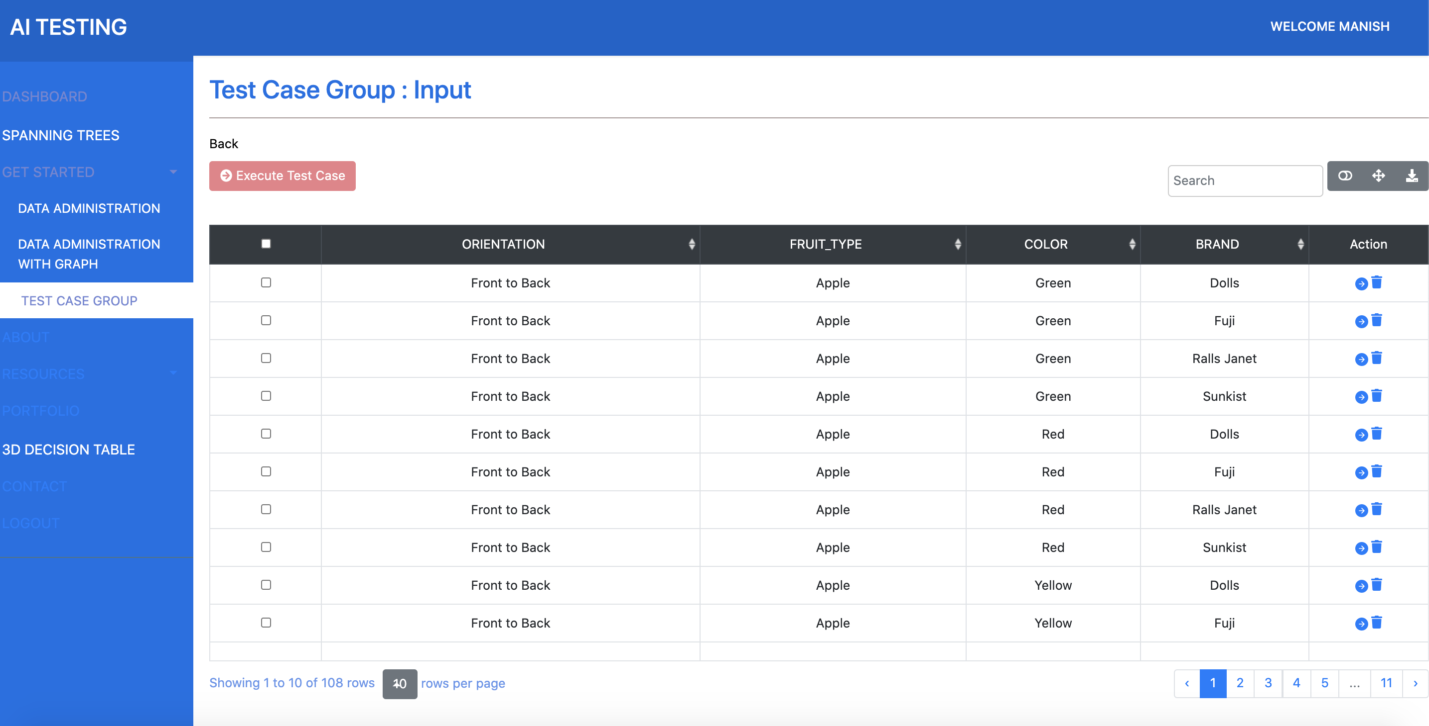
Test Case Group : Input
Change view
Card View
Full Screen Mode
Export to CSV
Search
Delete
View corresponding context test cases

Slide 27
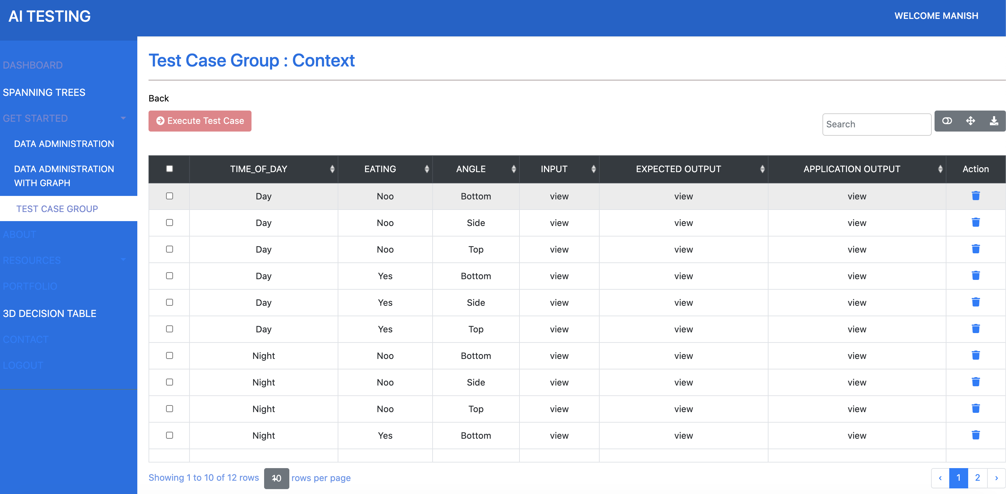
Test Case Group : context
Change view
Card View
Full Screen Mode
Export to CSV
Search
Delete
View/Add Input
View Output – Expected and Application

Slide 28
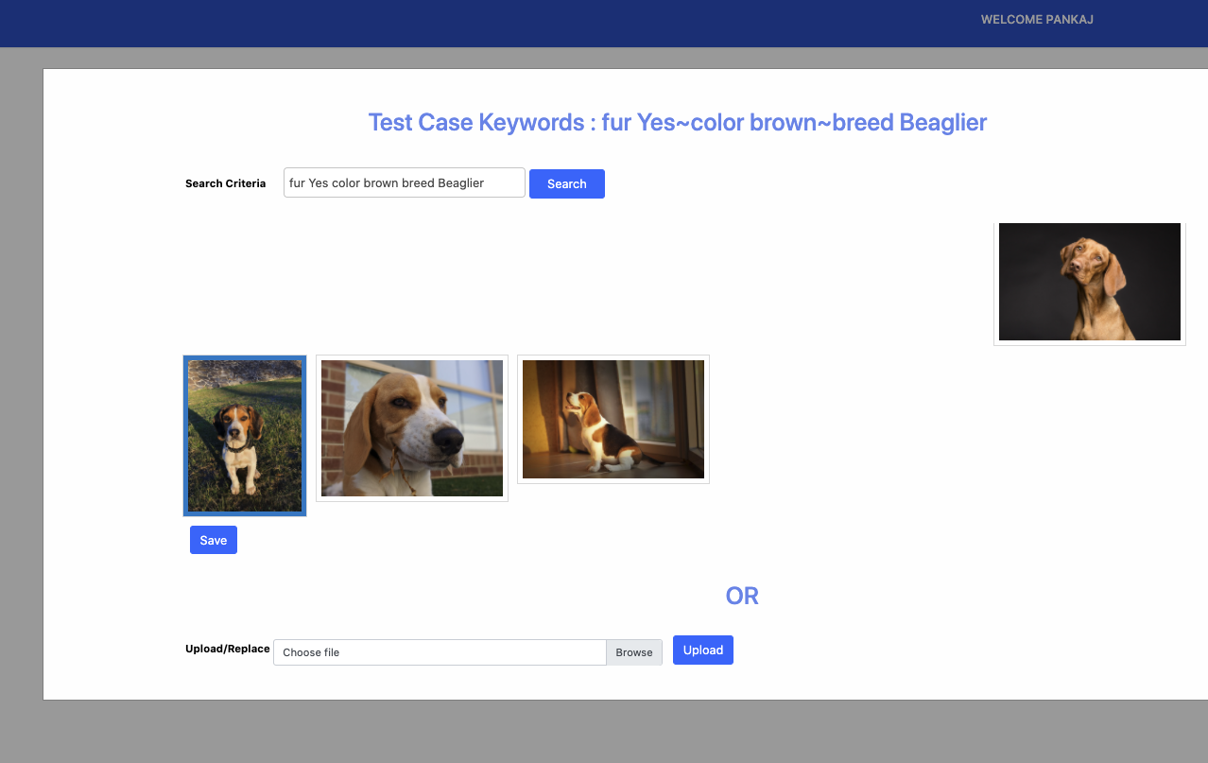
Test Case Group : context Input
Click on Input column of the context test case to
View
Add
Search from Google Images
Update the input

Slide 29
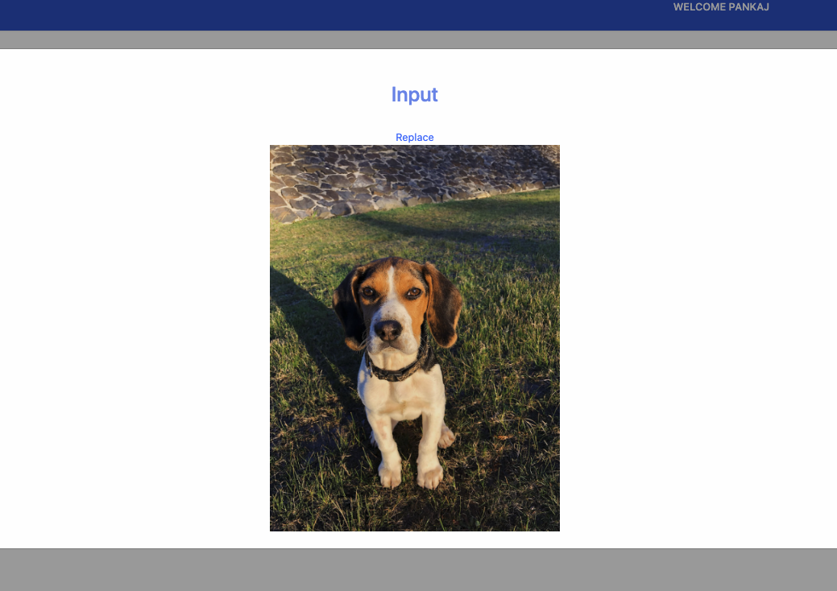
Test Case Group : Vicontext Input

Slide 30
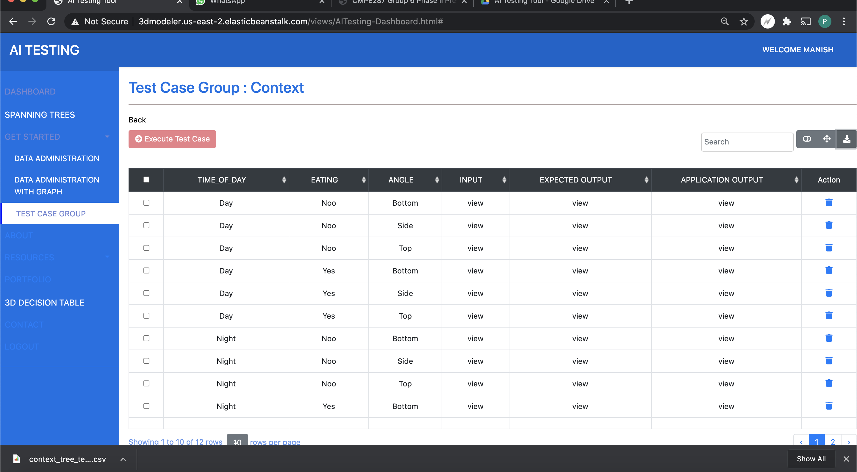
Export Data : Input and context

Slide 31
Sample Data
Input tree
https://drive.google.com/file/d/192SScizrgESDirShvFK0tKF_xMd7TSKS/view?usp=sharing
Context tree
https://drive.google.com/file/d/18Tb5LAzjtHQHKc_y2TYZTxjDxr8UhtKV/view?usp=sharing
Application URL : http://3dmodeler.us-east-2.elasticbeanstalk.com

Slide 32
Questions?

Slide 33
references
https://www.researchgate.net/publication/331730498_What_is_AI_Software_Testing_and_Why

